Slide 1
Town of Plymouth
Department of Public Works
Forges Field & 200-Acre Site
Pumping Effects Analysis for
Environmental Impact Study
Forges Field –
Capital Project Request
January 23, 2018

Slide 2
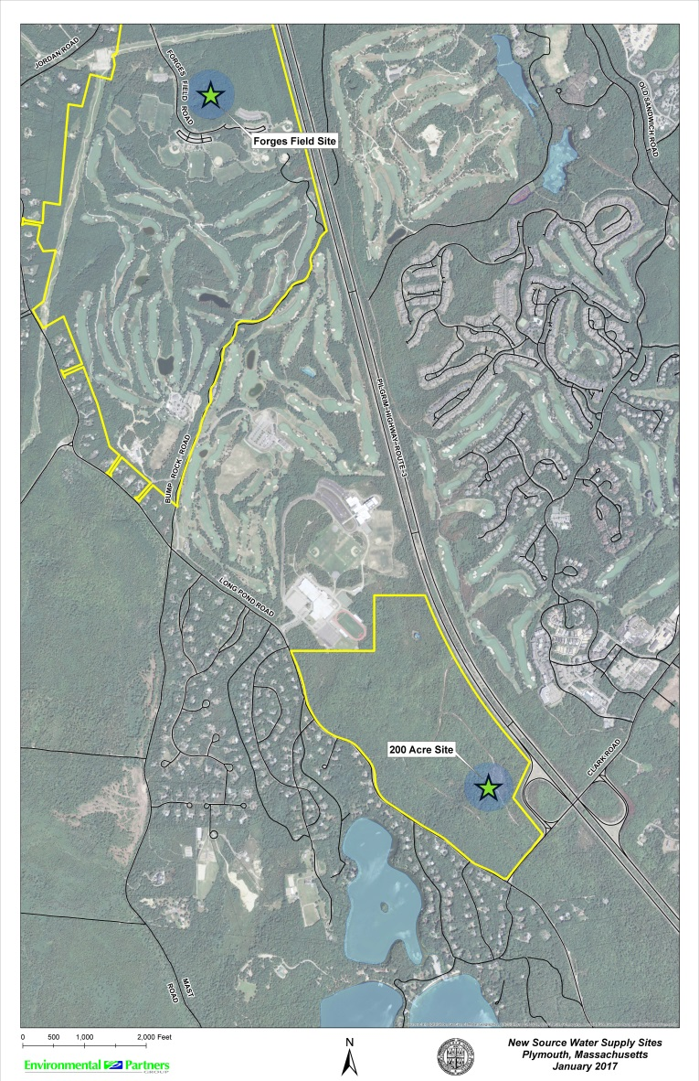
Plymouth New Source Water Supply
Development Program
Why new water supplies?
Background
Forges Field Site
  Eel River Modeling
  Effects to Nearby Wells
  Capital Project Request
200-Acre Site
  Introduction & Modeling Procedures
Forges Field Capital Schedule
Questions

Slide 3
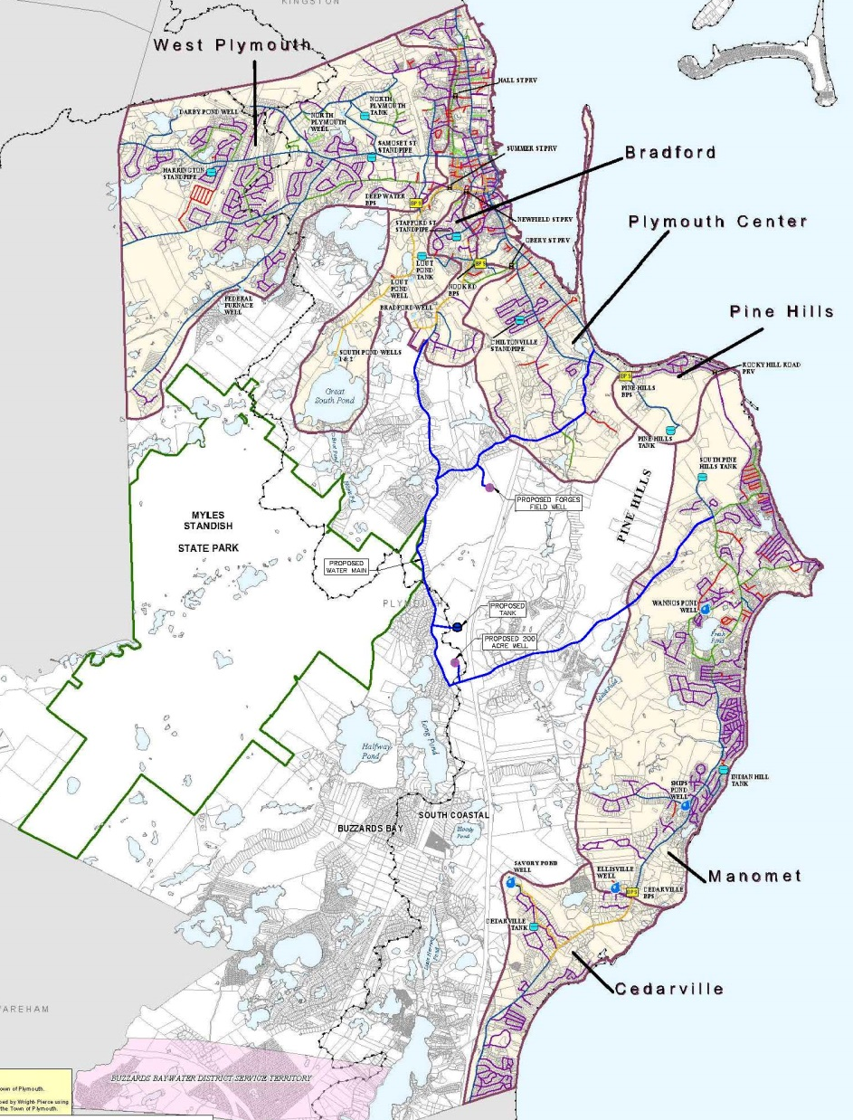
1. Why New Water Supplies?
Goal of New Source Development
  allow for future economic development and expansion of the water system
  provide emergency redundancy within the system, and allow for system flexibility of withdrawals and distribution
  allow Plymouth sufficient water system supply and flexibility to plan for long term sustainability.

Slide 4

1. Project Need
Water System Master Plan 2006:
  Need for additional water supplies and redundancy Issues at existing well sources
  Pressure zone deficiencies (Bradford, Cedarville, Manomet zones)
  Conservation use restrictions
  Water Storage Deficit

Slide 5
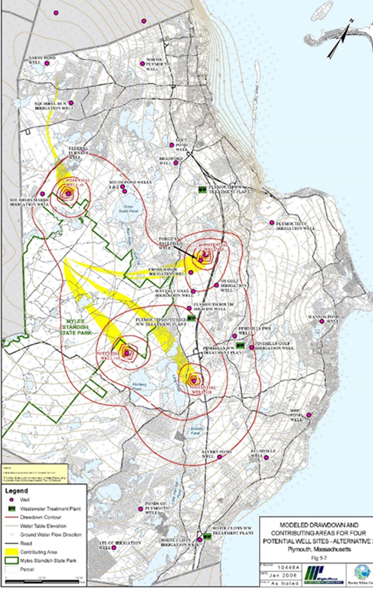
2. Background
Water System Master Plan (2006): identified 21 viable PWS sites
2008-2010: Exploratory drilling at 5 sites
Selected for further study:
Forges Field
200-Acre Site
Selected for Final Design/Permitting: Forges Field

Slide 6
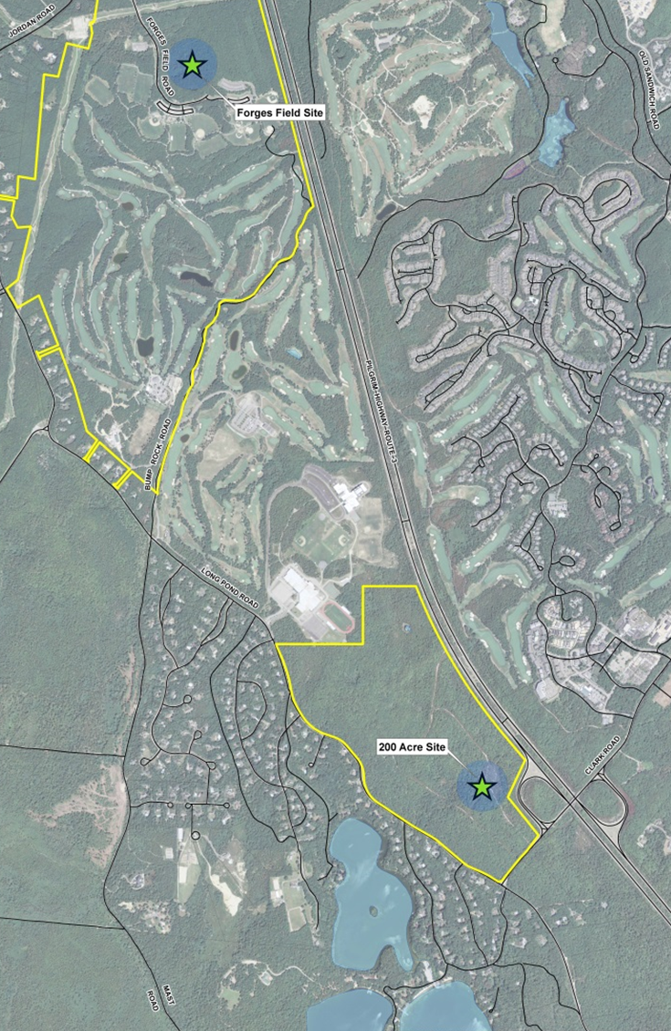
2. Background
Preliminary yield estimate (each sites) ~ 1 MGD
Forges Field
  additional study to address Zone I and well capacity issues (completed 2016/2017).
  Pump test 2017
  Extensive modeling 2017
  Provides immediate benefits to Town water system needs
200-Acre Site
  Pump test 2016
  Extensive modeling 2017
  Further study 2018

Slide 7
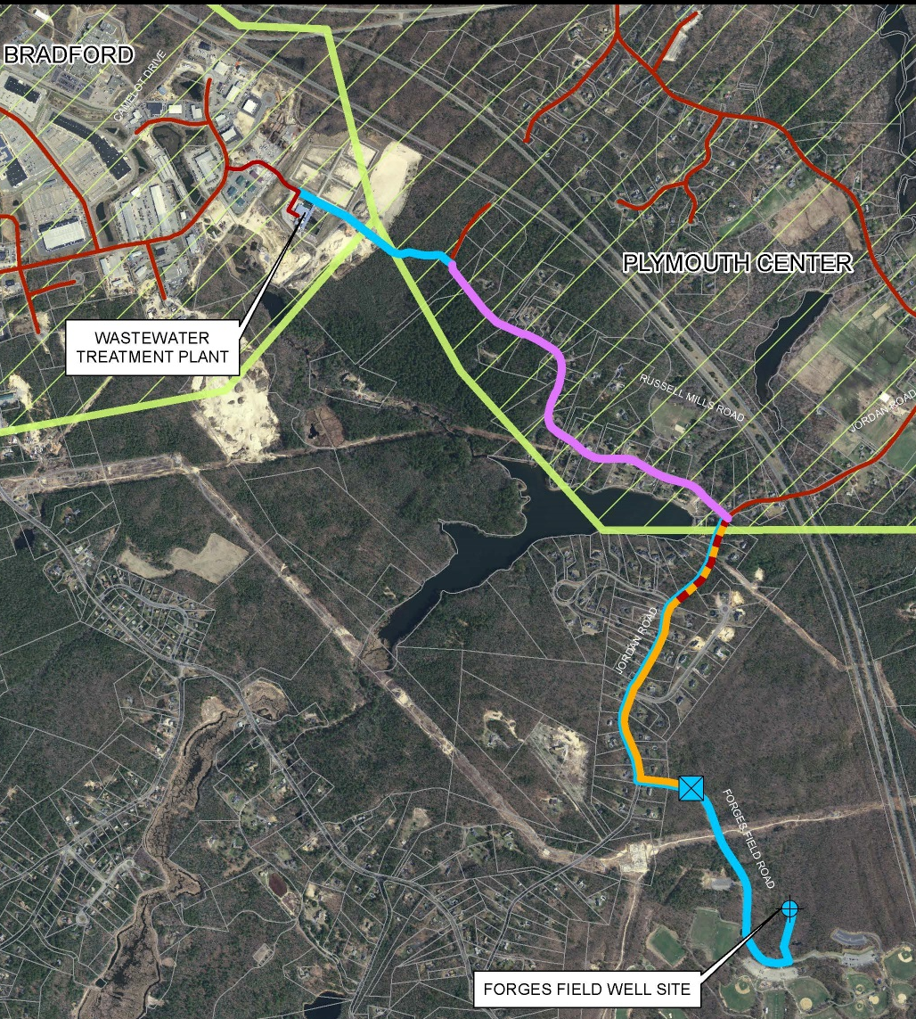
3. Forges Field Project Benefits
Reduced reliance on stressed sources
Additional water to meet summer demands
Redundancy for Plymouth Center & Bradford Zones
Improved service pressures

Slide 8
3. Forges Field Project Capital Request
Well Station with Chemical Addition for pH Adjustment
Approximately 3.5 miles of water main
Valve Control Station
Expansion of the Bradford Pressure Zone

Slide 9
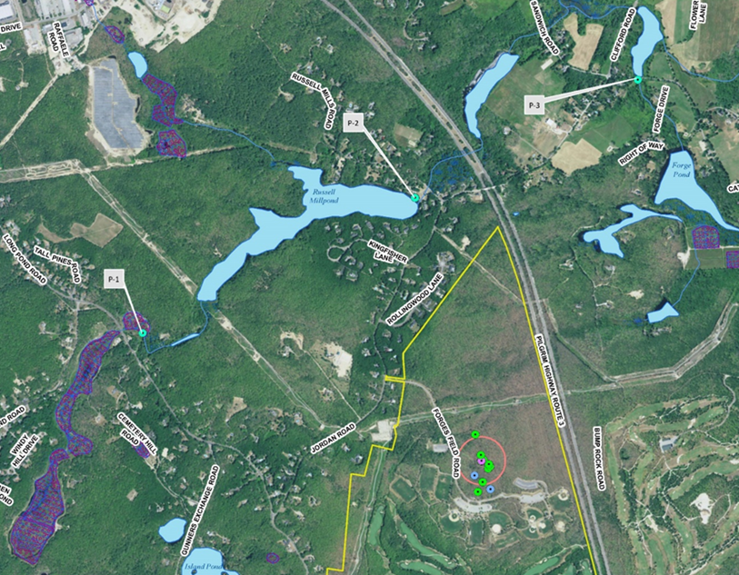
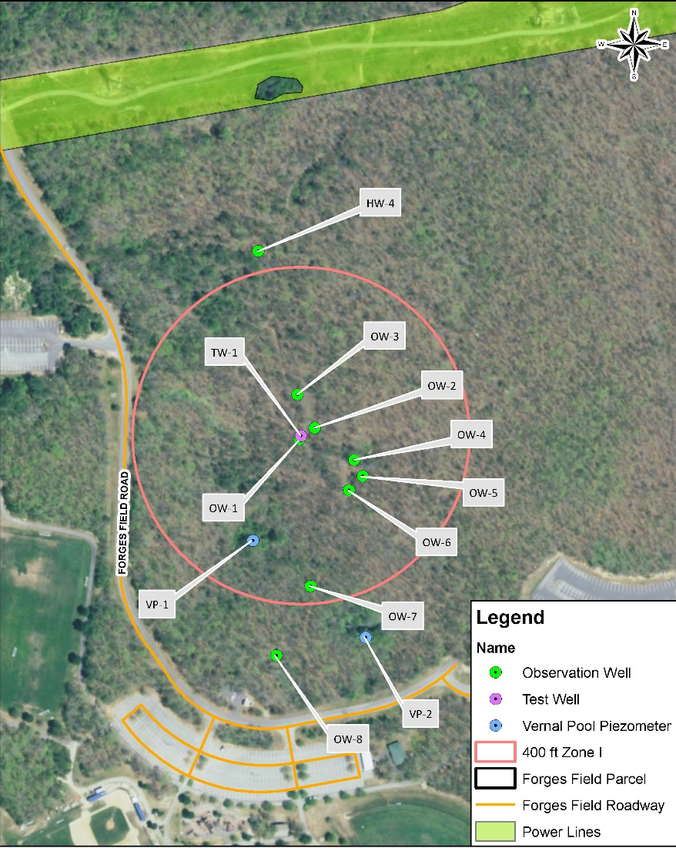
3. Forges Field Site
2016 Exploration
Test well, observation wells installed
Piezometers in Eel River
Depth to Water: 27’ bgs
Test Well Screen:110-125’ bgs
Pump Test (5 day): July 2017
Pumping Rate: 570 gpm
(0.82 MGD)
Approvable Yield: 1 MGD
Water Quality Excellent
(only pH adjustment)

Slide 10
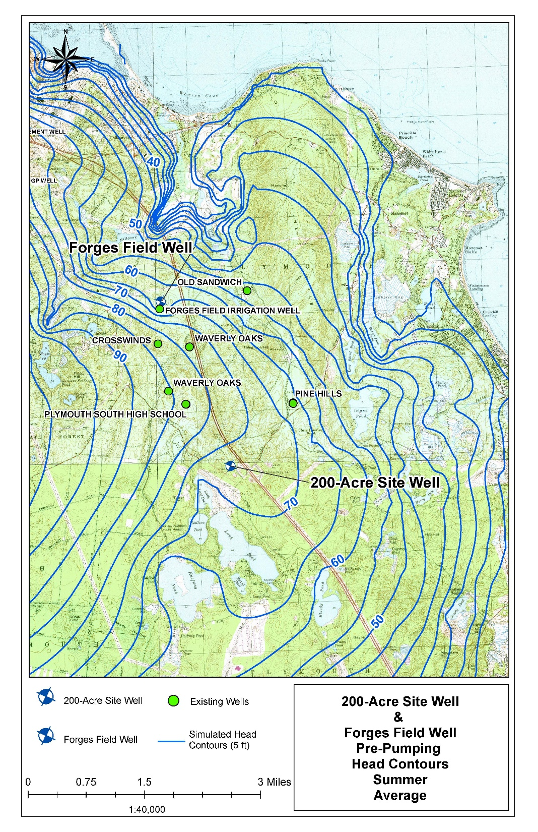
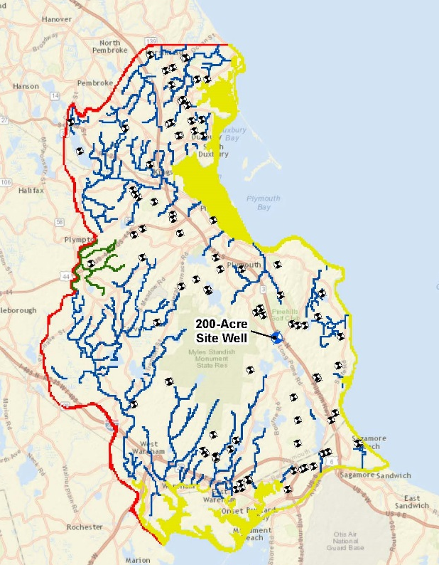
3. Groundwater Flow Map Pre-pumping
With all existing wells pumping

Slide 11
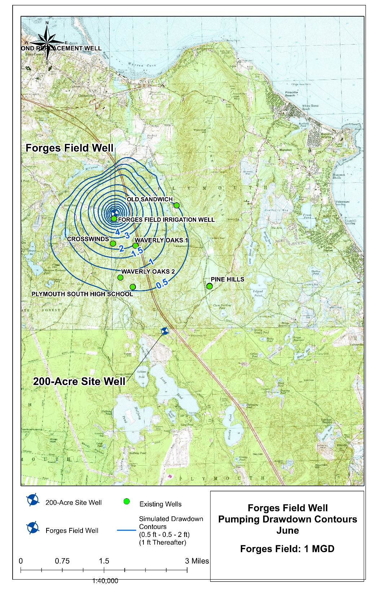
3. Water Level Drawdown with Forges Field Pumping at
1 MGD

Slide 12
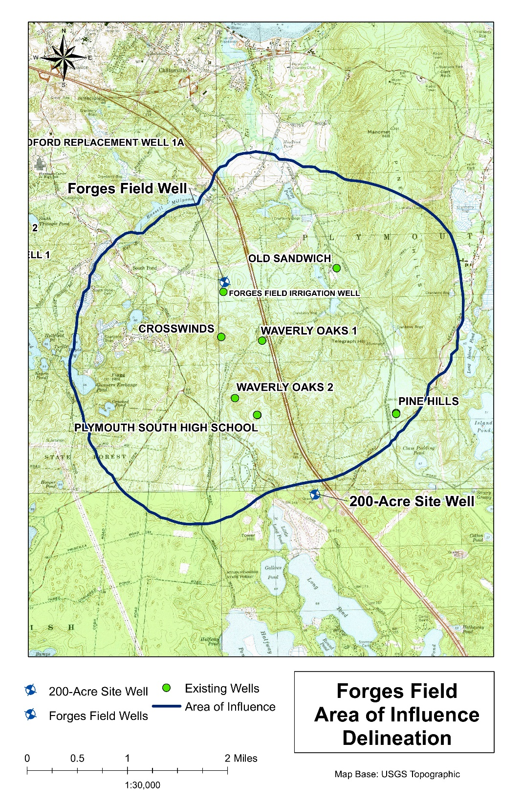
3. Forges Field Area of Influence at pumping rate 1 MGD
(=0.1 feet of drawdown)
Area of Influence required for DEP approval process

Slide 13
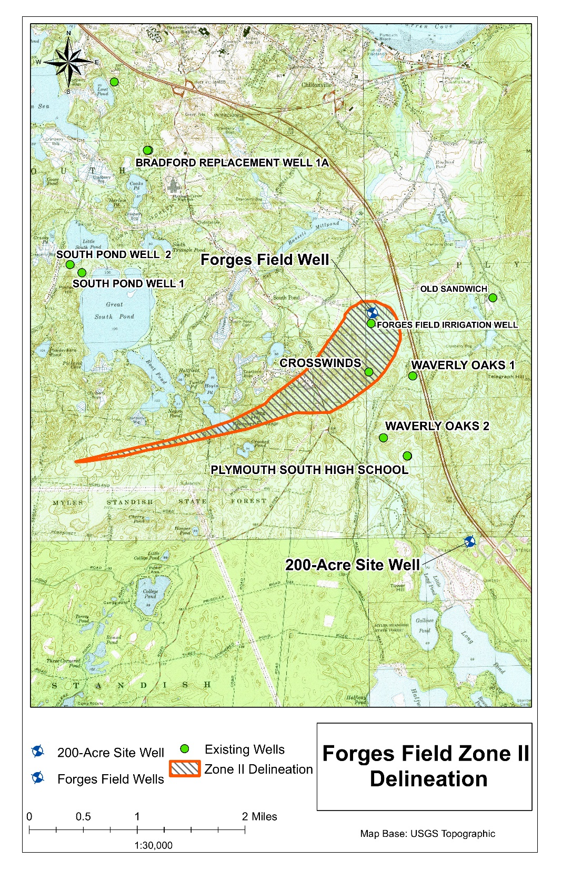
3. Forges Field Zone II
(pumping rate 1 MGD)
assumes 180 day of pumping with no recharge to aquifer

Slide 14
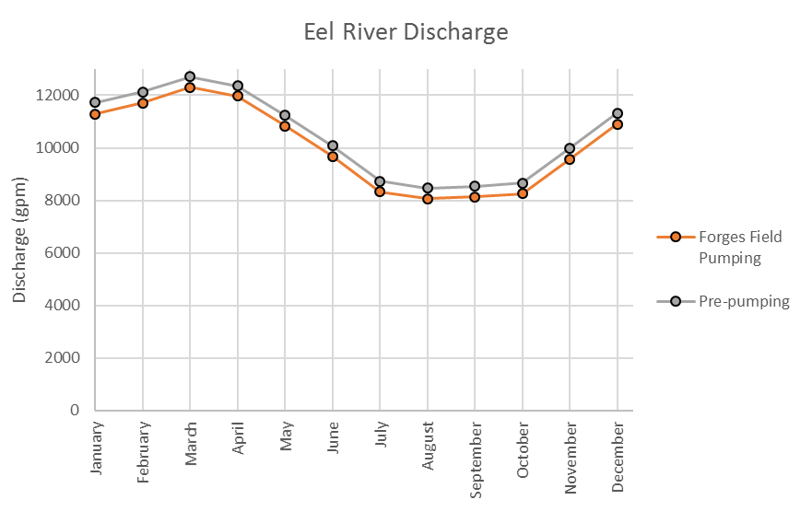
3. Forges Field Pumping Effects on
Eel River Discharge
 |  | May | June | July | August | September | October | November | December | January | February | March | April
Pre-pumping | Discharge (gpm) | 11,230 | 10,070 | 8,730 | 8,470 | 8,530 | 8,660 | 9,990 | 11,330 | 11,730 | 12,120 | 12,710 | 12,370
Forges Field: 1 MGD | Discharge (gpm) | 10,830 | 9,680 | 8,330 | 8,070 | 8,130 | 8,250 | 9,580 | 10,910 | 11,300 | 11,710 | 12,310 | 11,960
 | Total Change in Discharge (gpm) | 400 | 400 | 400 | 400 | 400 | 410 | 410 | 420 | 430 | 410 | 400 | 400
 | Percent Change | 3.5% | 3.9% | 4.6% | 4.7% | 4.7% | 4.7% | 4.1% | 3.7% | 3.7% | 3.4% | 3.2% | 3.3%
*Discharge values rounded to the nearest 10 gallons
DRAFT

Slide 15
3. Forges Field Pumping Effects to Existing Wells
 |  | Crosswinds | FF Irrigation | Old Sandwich | Pine Hills | SPHS | Waverly Oaks 1 | Waverly Oaks 2
Pumping Rate | Average Pumping Rate (GPD) | 88,029 | 27,919 | 131,220 | 410,711 | 9,376 | 181,474 | 0
 | Annual Pumping Rate (MGY) | 32 | 10 | 48 | 150 | 3 | 66 | 0
Post-Forges Field Pumping | Avg. Summer Drawdown (feet) | 2.4 | 11.1 | 0.5 | 0.2 | 0.5 | 2.0 | 0.8
 | Minimum Available Water Above Well Screen (ft) | 64.8 | 53.3 | 27.7 | 60.0 | 66.2 | 42.8
No Adverse Affects to Existing Wells

Slide 16
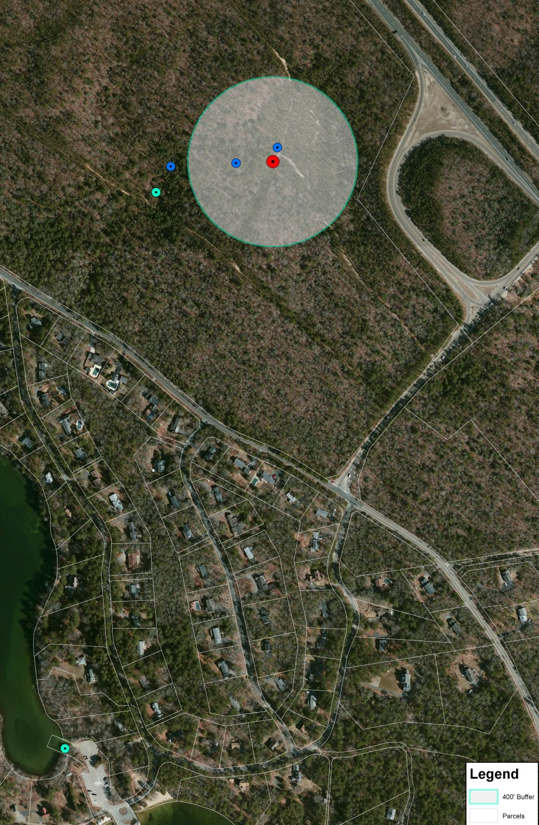
4. 200-Acre Site
Test well, observation wells installed
Piezometer in Little Long Pond
Depth to Water: 50’ bgs
Test Well Screen:116’ to 131’ bgs
Pump Test (5 day): August 2016
Pumping Rate: 790 gpm (1.13 MGD)
Approvable Yield: up to 2.27 MGD
Water Quality Excellent (only pH adjustment)
Requesting 1 MGD
Further study and analysis in 2018

Slide 17
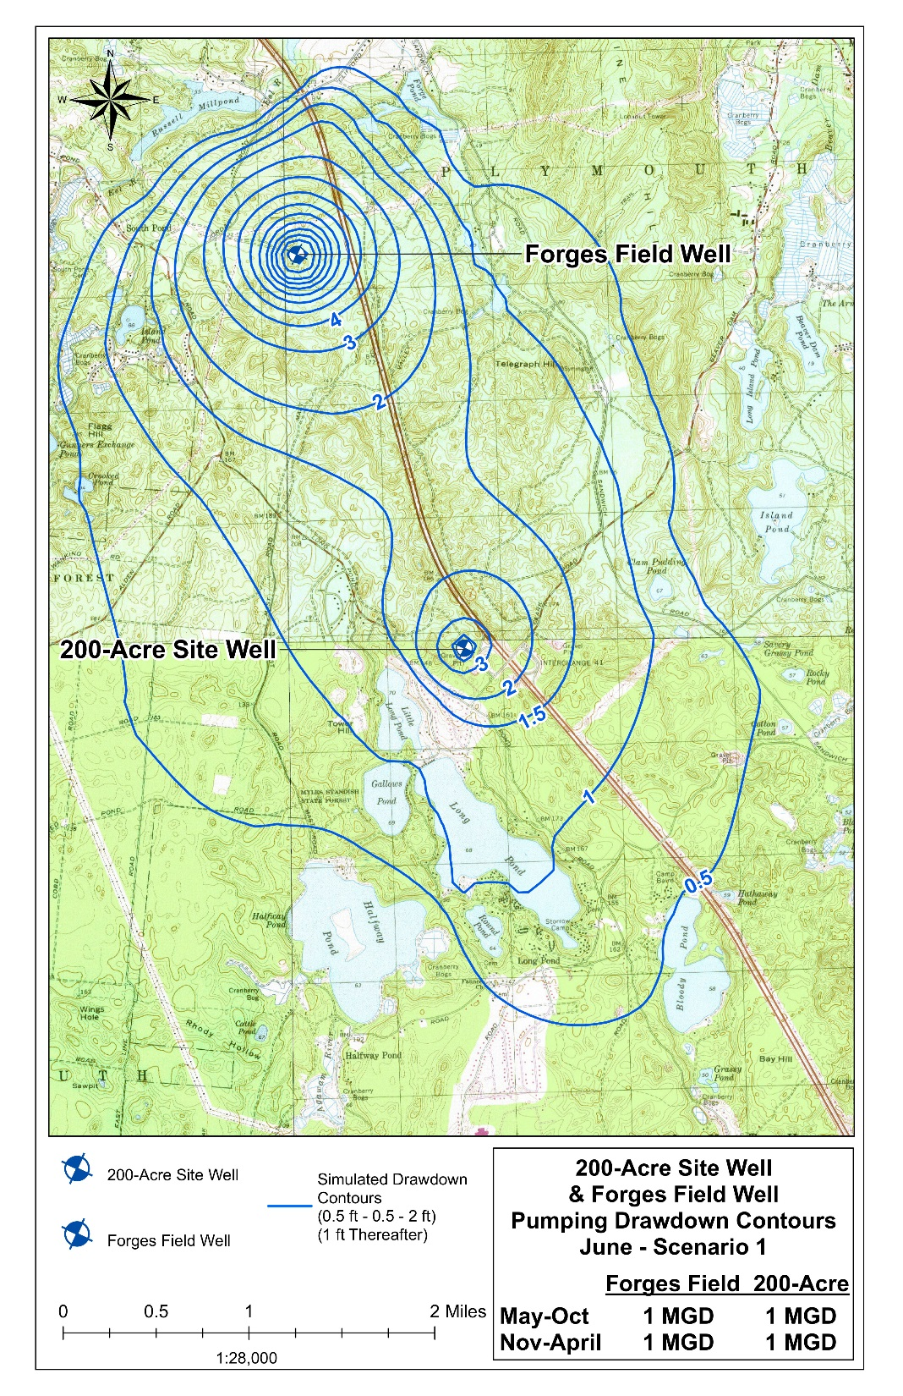
4. 200-acre & Forges Combined Drawdown Map

Slide 18
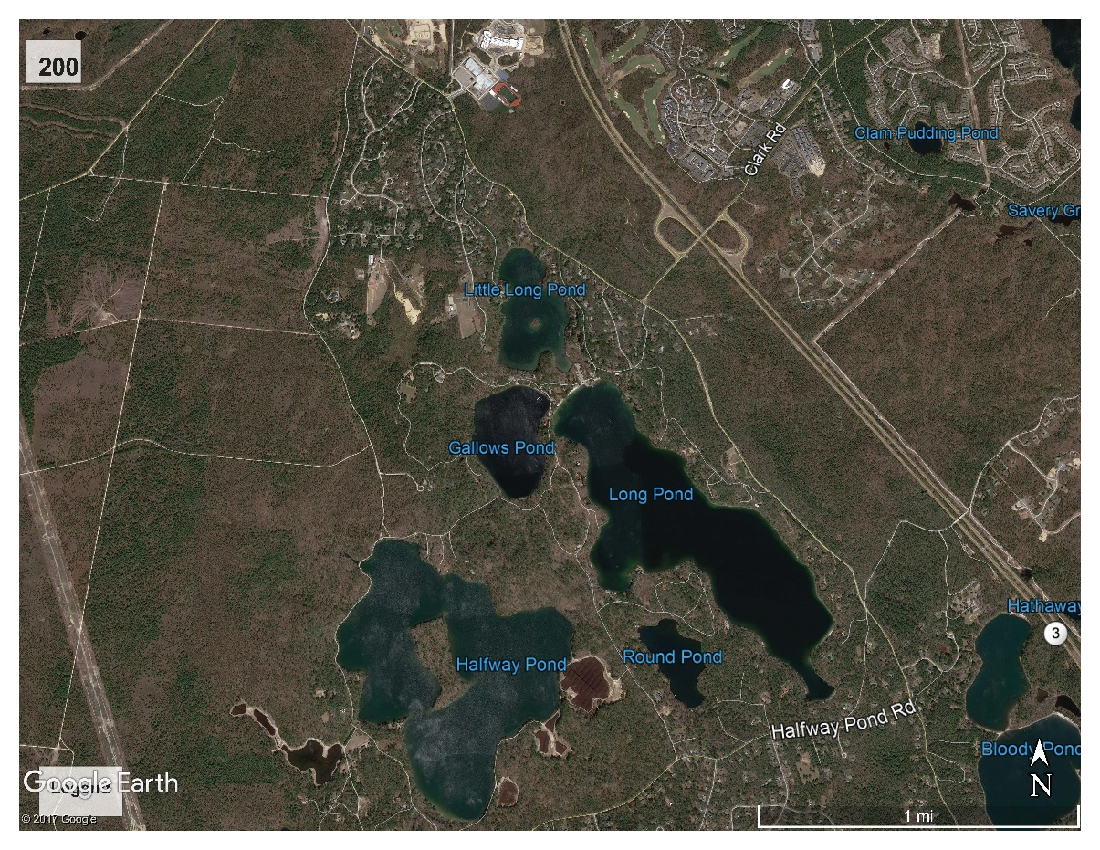
4. Water Level Drawdown at 6 Ponds
Pumping | Value | Drawdown/Lowering (ft.)
 |  | TW-1 | Little Long Pond | Long Pond | Gallows Pond | Round Pond | Halfway Pond | Bloody Pond
Forges Field: 1 MGD 200 Acre: 1 MGD | Max. | 9.3 | 1.1 | 1.0 | 0.8 | 0.7 | 0.1 | 0.5
 | Min. | 9.2 | 1.1 | 1.0 | 0.8 | 0.7 | 0.1 | 0.5
 | Avg. Summer | 9.2 | 1.1 | 1.0 | 0.8 | 0.7 | 0.1 | 0.5
 | Avg. Winter | 9.2 | 1.1 | 1.0 | 0.8 | 0.7 | 0.1 | 0.5

Slide 19
4. 200-Acre Site Summary
Updated the USGS Groundwater Flow Model (2009) with site specific data, including:
  Site Specific Aquifer Characteristics
  Pond Bathymetry
  Updated Pumping Rates for Area Wells
Developed Pond Profiles for All 6 Ponds
Modeled the following for All 6 Ponds
(with 200 Acre and Forges each pumping at 1 MGD):
  Pond Water Levels Monthly
  Pond Area Reduction due to Pumping
Next Steps
  Discussions with Regulators
  Public Outreach
200 Acre Site

Slide 20
5. Forges Field Capital Project Summary
Calibrated hydraulic model utilized to determine extents of pressure zone
Forges Field Well Station
  pH Adjustment
Valve Control Station
  Interconnect Plymouth & Bradford Zones

Slide 21
5. Forges Field Capital Project Summary
Water Mains
  Water Mains interconnect Forges Well, Valve Station and service to pressure zones
  Replacement of old undersized main in Russell Mills Road
  Parallel water mains along Jordan Road to each pressure zone
Final Design On-Going

Slide 22
5. Forges Field Capital Project Summary
Permitting requirements with State & Local Agencies
  Plymouth Conservation Commission
  Forges Field Well Pump Test Report
  Expanded ENF with MEPA
  MassDEP Permitting
    WS20 – Approval to Construct Source
    WS32 – Distribution System Modifications
    WM03 – Water Management Act Permit Amendment

Slide 23
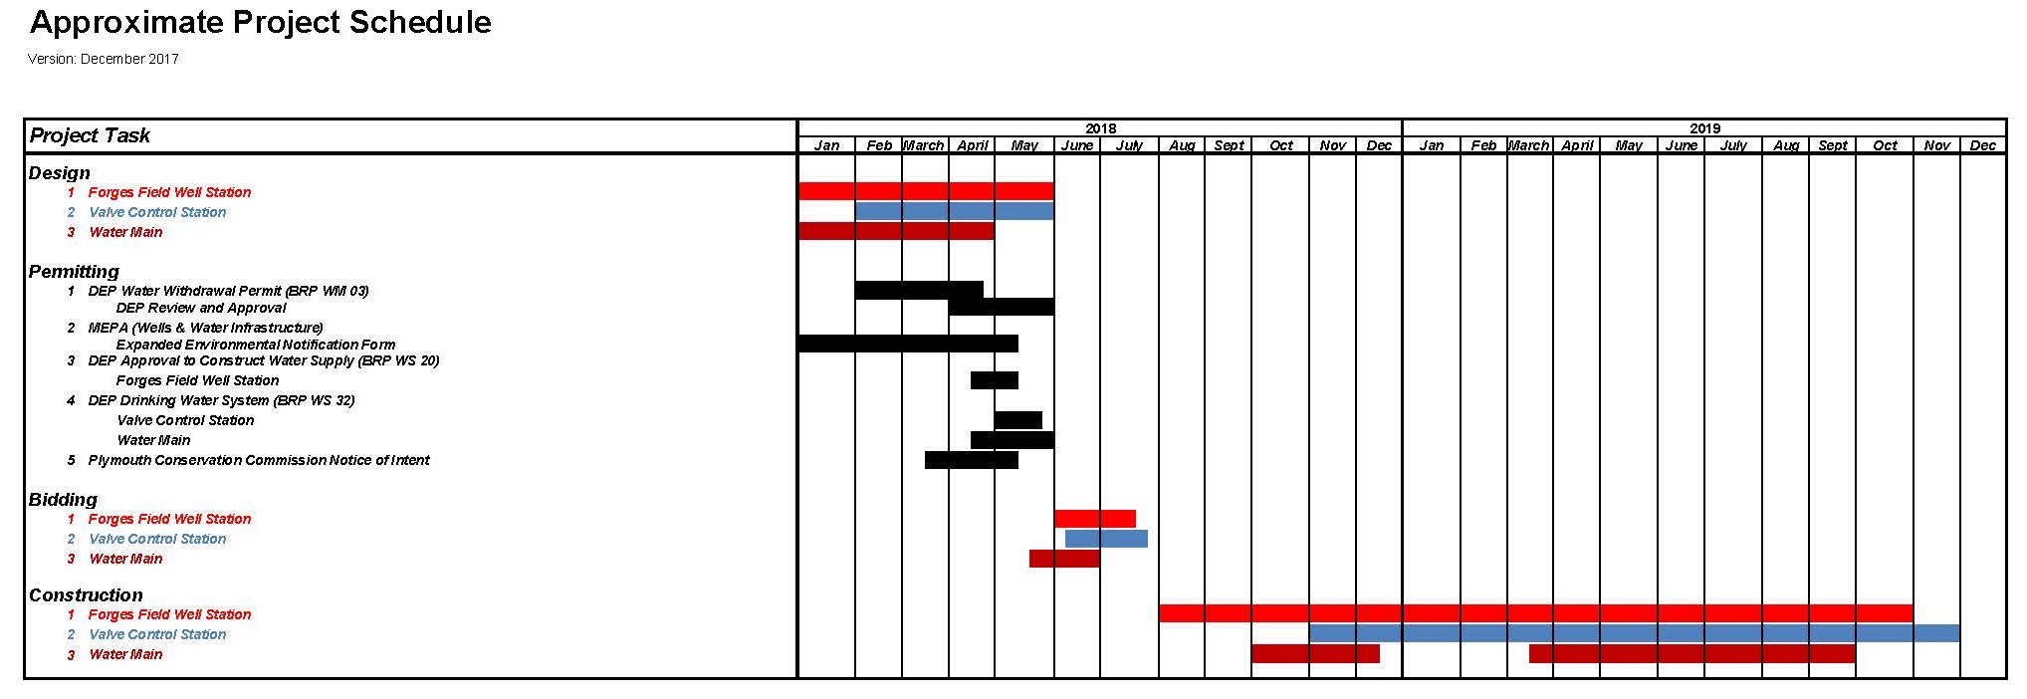
5. Forges Field Capital Project Schedule

Slide 24
5. Forges Field Capital Project Schedule
Design, Permitting & Bidding Services Approved at April 2017 Town Meeting
  Design & Permitting currently on-going
  Design & Permitting completed in early late Spring early Summer 2018
  Bidding June 2018
Pending Town Meeting Action:
  Construction – July/August 2018 – April 2020

Slide 25
5. Forges Field Capital Project Cost
Item | Total
Well Station | $1,800,000
Water Mains | $3,000,000
Valve Control Station | $800,000
CONSTRUCTION SUBTOTAL | $5,600,000
Construction Phase Engineering (20%) | $1,120,000
Police Details | $125,000
Contingency (15%) | $1,026,750
TOTAL | $7,871,750
SAY | $8,000,000

Slide 26


Forges Field Project:
Problems Solved…
Additional Water to Meet Summer Demands
Water System Redundancy
Reduced Reliance on Stressed Water Sources
Expanded fire protection
Water System Sustainability for the Future

