Slide 1

Update to
Town of Plymouth
Select Board
Tuesday, April 1, 2025
Plymouth HHS
“The Bridge to Resources in Our Hometown”
1

Slide 2
Plymouth HHS Mission & Overview
Mission: Building bridges to community wellbeing, the mission of the Plymouth Health and Human Services Department (HHS) is to connect people with vital resources within the framework of a healthy, humanistic, sustainable, and resilient community. Our goal is to foster a comprehensive and compassionate social health support system that promotes a culture of belonging and cohesiveness for residents and visitors alike
Divisions: Center for Active Living, Library, Public Health, Recreation, and Veterans Services

Slide 3

HHS Commissioner’s Spotlight
Plymouth ARISE
FY’26 Strategy

Slide 4
Plymouth ARISE
Plymouth Addiction Response and Improvement Strategies Effort (ARISE) is the Town’s coordinated response to the local opioid epidemic that aims to increase community engagement and reduce stigma around opioids/other substance use, while strengthening community capacity and enhancing resources for residents
Funding provided through MA municipal abatement funds and federal litigation settlements

Slide 5
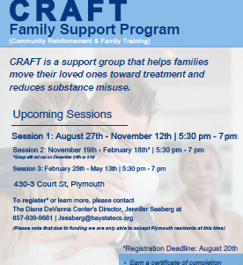
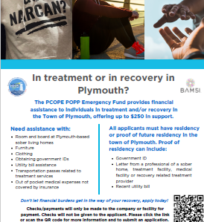
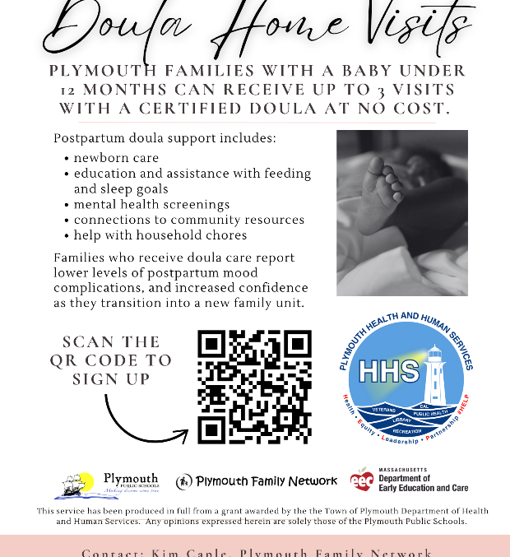

FY’25 Grantees
Bay State Community Services
Brockton Area Multi-Services, Inc. (BAMSI)
High Point Treatment Center
Plymouth Public Schools
To The Moon And Back

Slide 6
Plymouth ARISE Leadership By The Numbers…
$295,171.43 Total municipal abatement funds expended to date
100’s of Plymouth children, adults, and families served by FY’25 ARISE Grantees
50+ Grantee emergency/recovery scholarships issued to Plymouth youth/adults
16 HHS site visits/meetings with local opioid resources and partners
12 NaloxBoxes placed in key areas around Plymouth by Grantees
7 out of 7 MA state opioid abatement target strategies met by Grantees
6 HHS consultations completed as requested by other MA municipalities
3 HHS community forums held on local impact of opioids/abatement funding

Slide 7

Plymouth ARISE Stories
Our “Why” in Plymouth…
“I want to be a better man, son and father to my child…”
– WRAPP participant
“These children are at risk of stigma due to their birth history and high rate of behavioral health diagnosis. Our research shows that they are underserved compared to their peers…”
– Caring for Children with POE Project
(Plymouth HHS, 2025)

Slide 8
Plymouth ARISE At–A–Glance
Recent Updates FY’25
FY’26 Timeline
FY’25 ARISE Grantees provided 3 quarters of pilot project data
Data shows Grantees serving range of residents including at-risk kids, parents/caregivers, grandparents, and veterans
Data demonstrates Grantees on track to meet project goals and key innovations
Community forum on 4.01.2025
RFP issued to public 4.01.2025
RFP applications due 5.01.2025
ARISE Review Committee evaluates applications/selects grantees
FY’26 grantees notified in June 2025
Funds disbursed in early FY’26 (upon receipt of contracts)

Slide 9
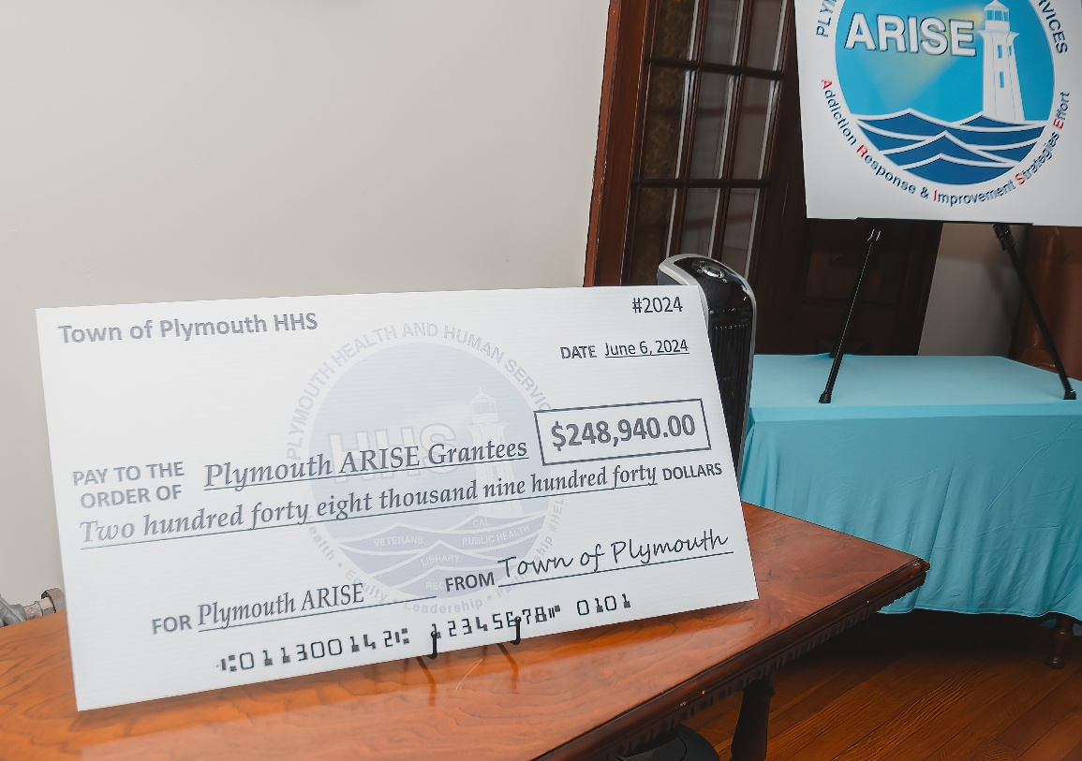
Where We’ve Been & Where We’re Going…
Mass Municipal Association’s The Beacon (Jan 2025)
WBUR News (Dec 2024)
Visit by Sen. Warren (Oct 2024)
Mass Nonprofit News (Aug 2024)
WCVB Channel 5 News (June 2024)
Plymouth Independent (Jan 2024)
MA Municipal Opioid Abatement Conference Panel (May 2025)

Slide 10




FY’26/Beyond Strategy
Connect residents to critical opioid-involved resources
Create Plymouth toolkit requested to share at the state level
Align with state goals of regional collaboration and creation of specialized positions to maximize impact
Increase opioid disbursement in FY’26
Serve as a model for municipal collaboration
Notes:
See changes

Slide 11
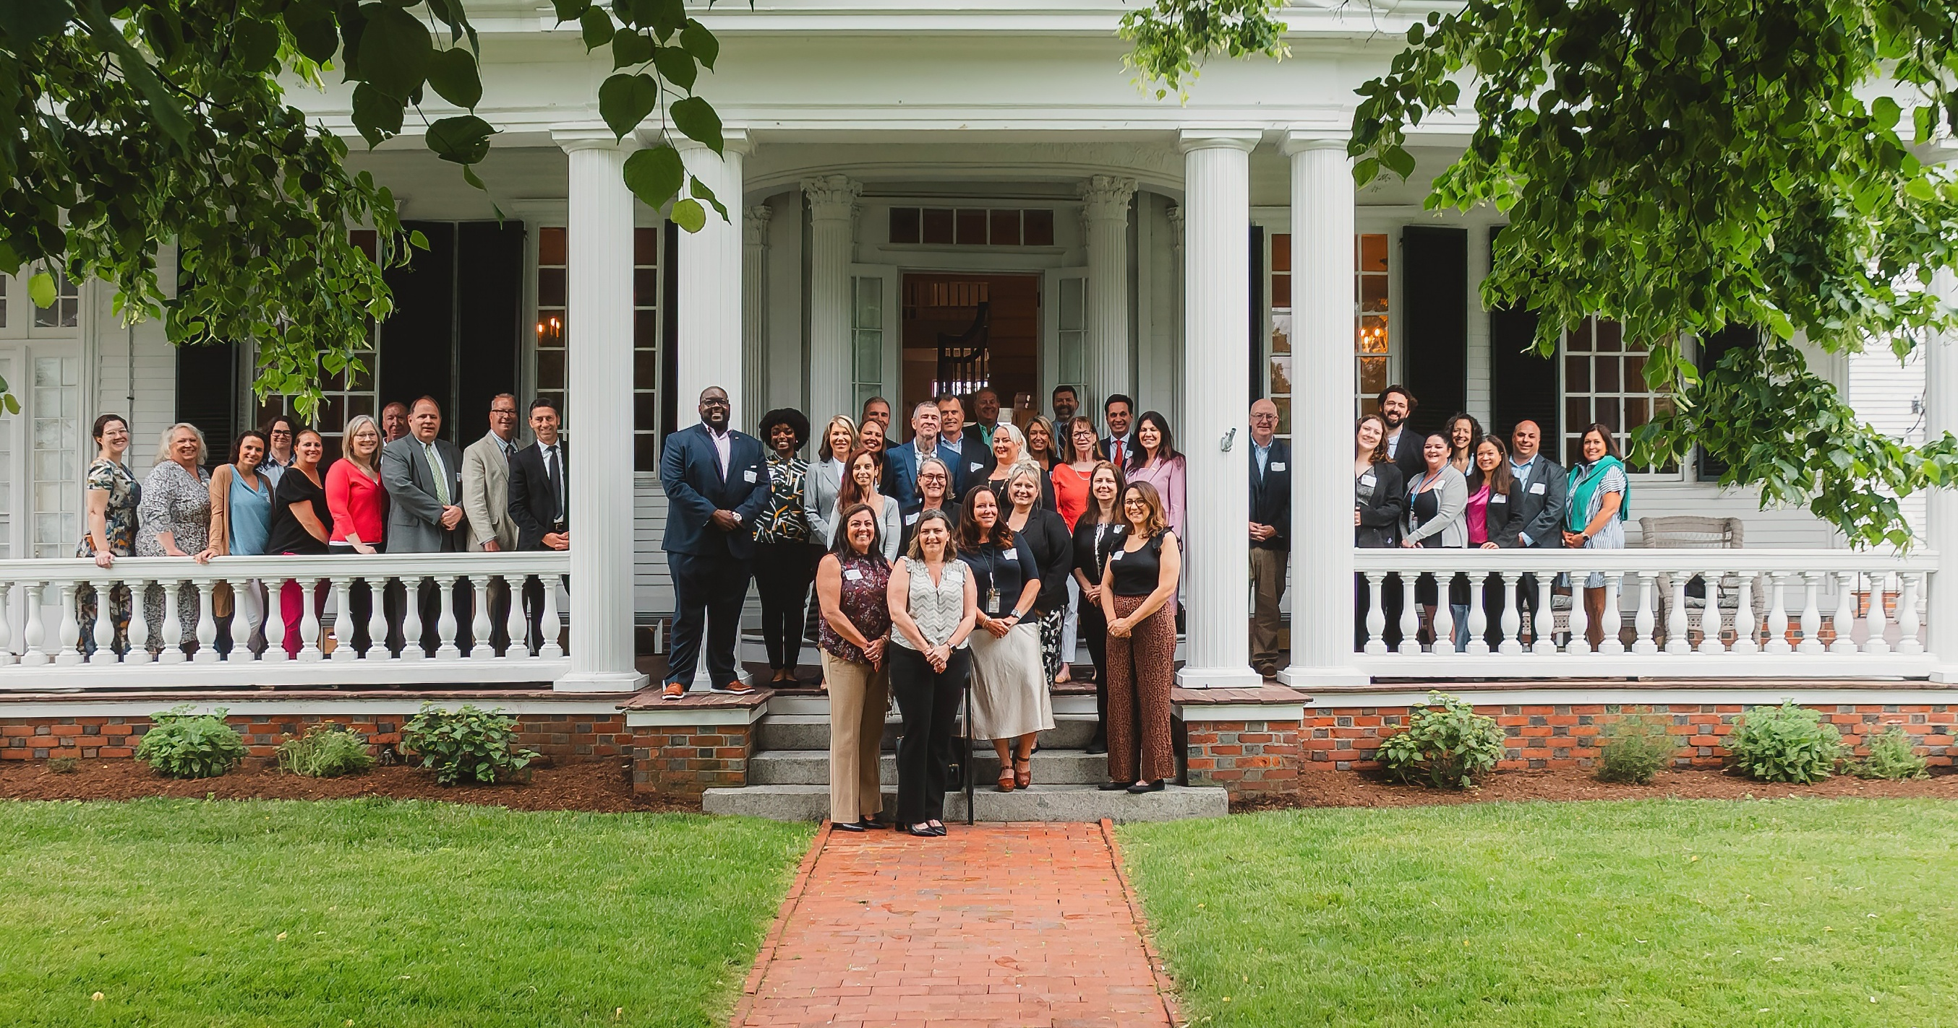
Save the Date!
2nd Plymouth ARISE Ceremony
June 10, 2025
11

